Slide 1
EMPLOYEE MANAGEMENT SYSTEM
Presented by :-
Rakesh (4DM16IS033)
Nithin Kumar (4DM16IS024)
Sunil Achar (4DM16IS043)
N.Thushar (4DM16IS019)

Slide 2
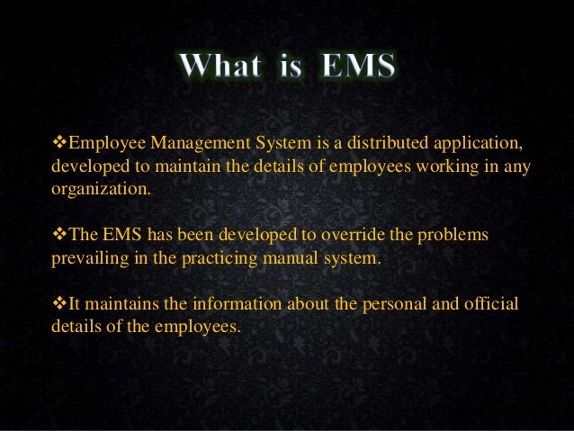

Slide 3
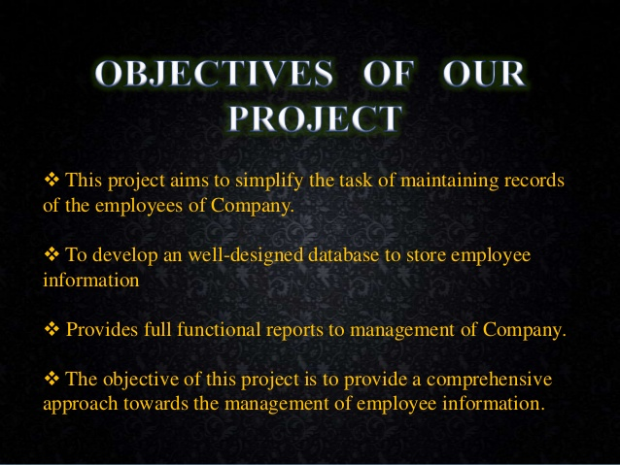

Slide 4
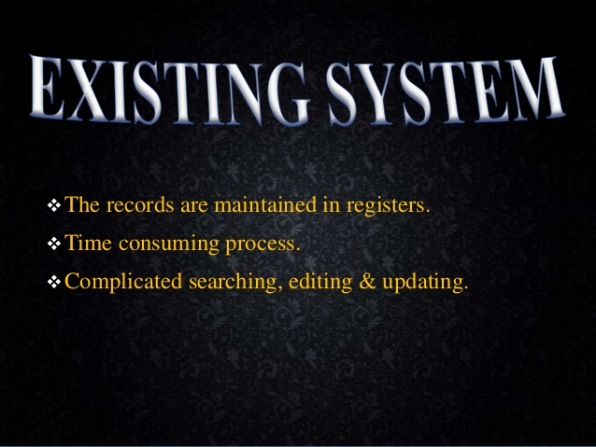

Slide 5
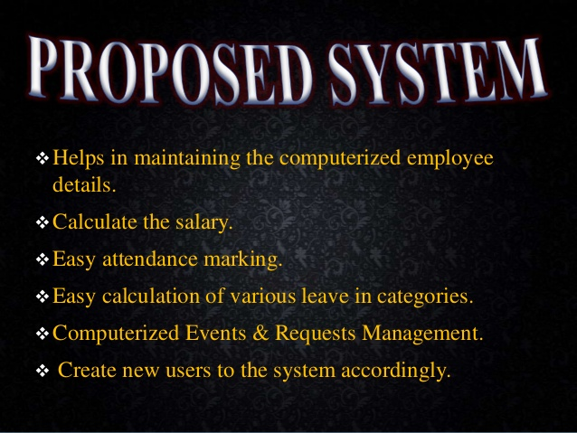

Slide 6
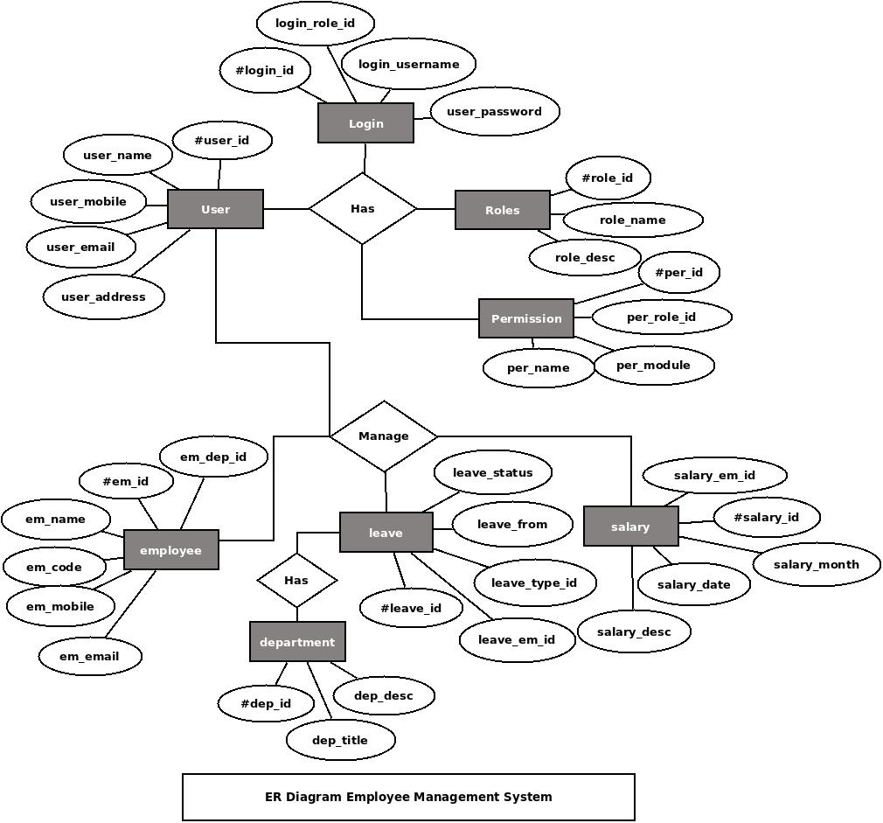

Slide 7
REQUIREMENTS :-
Hardware:PC with 500GB HDD and 2GB RAM
Processor:Intel Pentium
Operating System:Windows or Linux
Front end:HTML5 and CSS
Back end :SQL and PHP , JAVA

Slide 8


Slide 9
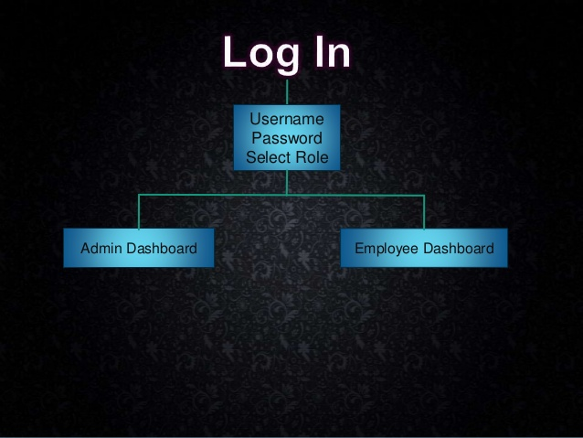

Slide 10
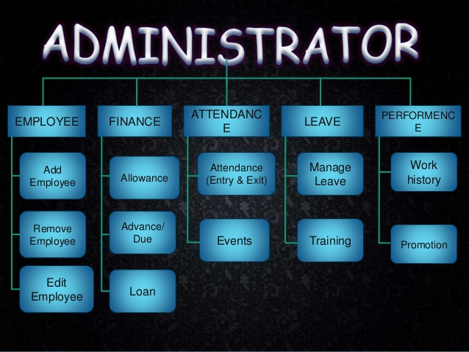

Slide 11
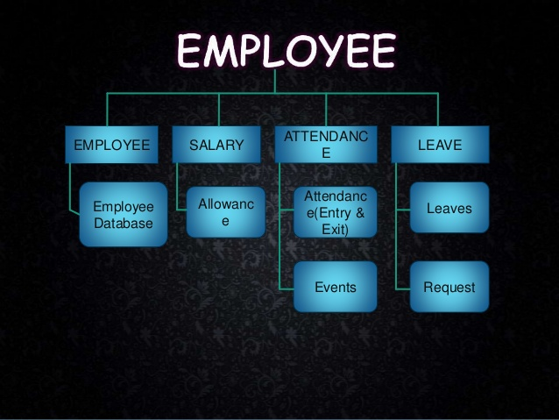

Slide 12
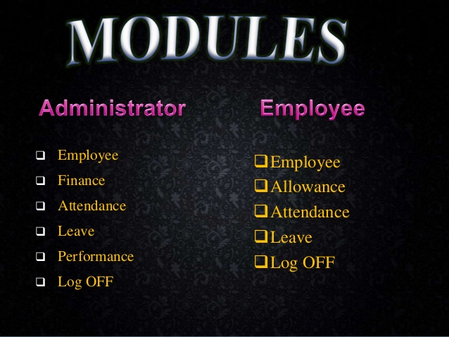

Slide 13
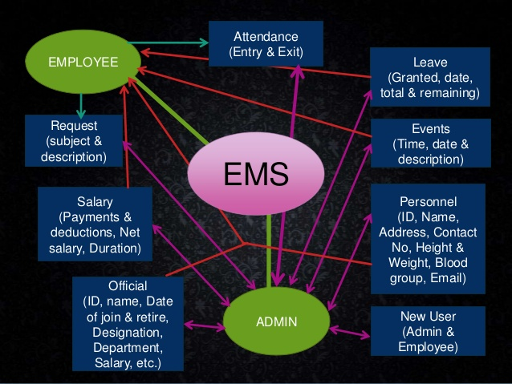

Slide 14
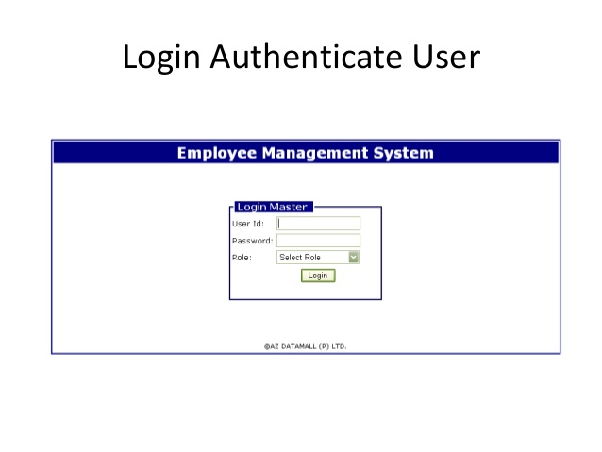

Slide 15
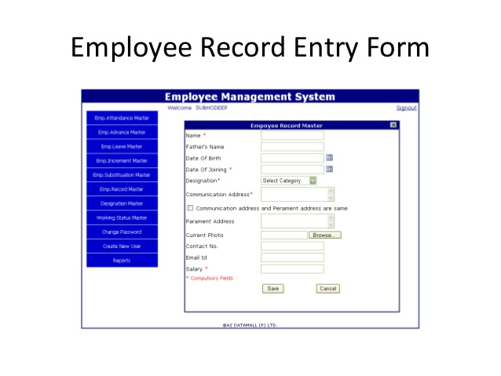

Slide 16
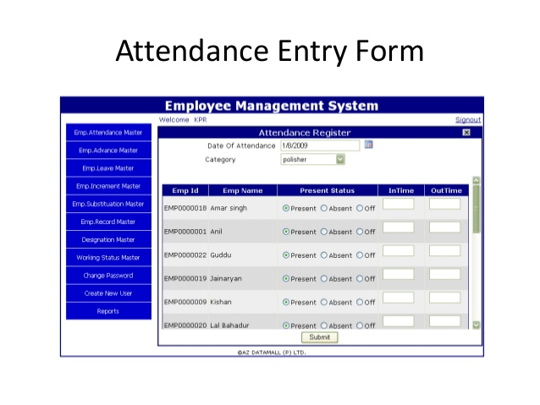

Slide 17
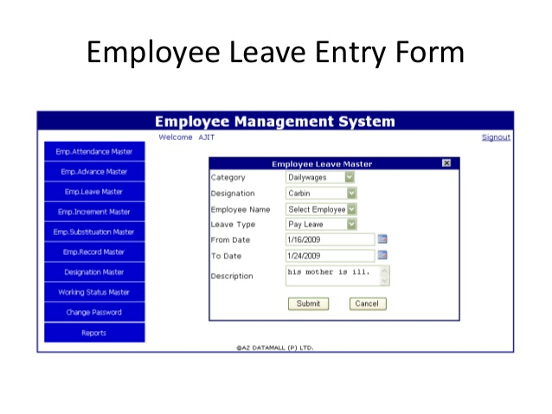

Slide 18
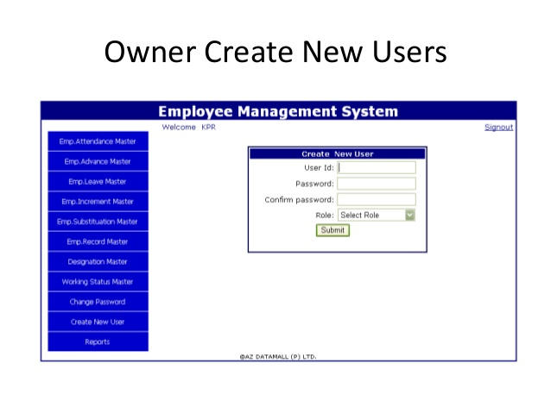

Slide 19
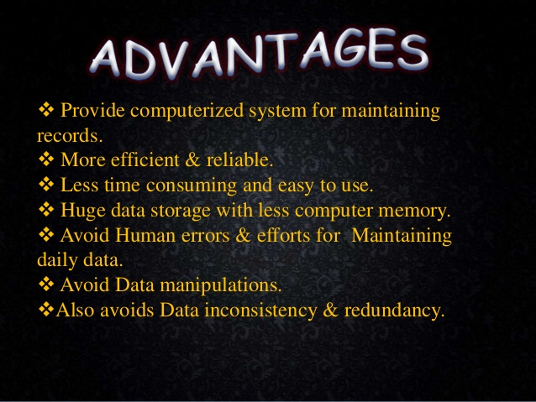

Slide 20
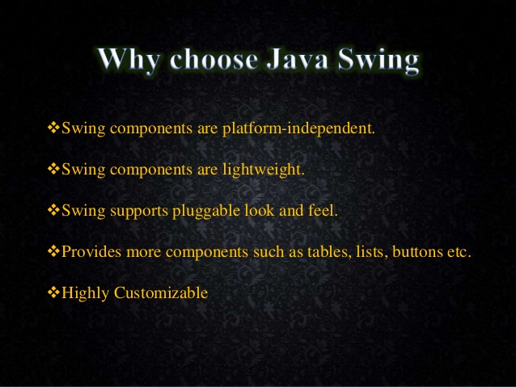

Slide 21
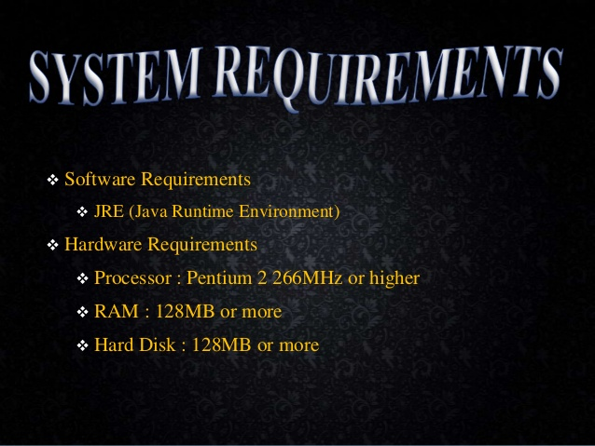

Slide 22
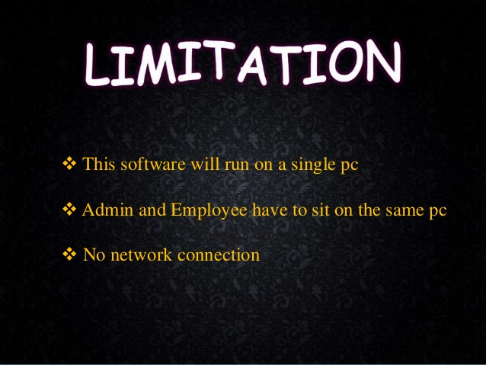

Slide 23


